Slide 1

Inequalities and wage progression in low-skilled jobs
Rachel Griffith
Notes:
40-minute presentation followed by a 15 minutes Q&A
Hi. Thank you very much for the invitation, and I’m sorry that I couldn’t be there in person.
I am going to talk about the rising inequalities that we see, particularly in the UK, US and I believe that also we see many similar trends in Canada, and what policies might be effective at tackling them.

Slide 2
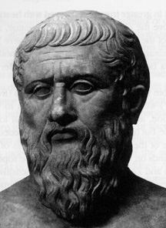
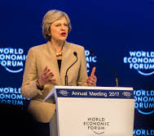

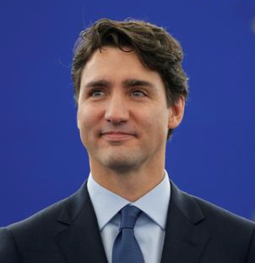
Widespread and long standing concerns about inequalities
"There should exist among the citizens neither extreme poverty nor again excessive wealth, for both are productive of great evil"
Plato 360 BCE
“we need to act to address the deeply felt sense of economic inequality that has emerged in recent years”
Teresa May at Davos, January 2017
“The real inequality is not due to tax... the real inequalities are inequalities at birth”
Emmanuel Macron, April 2019
“When companies post record profits on the backs of workers consistently refused full-time work – and the job security that comes with it – people get defeated.”
Justin Trudeau, February 2017
Notes:
There is a long and widespread concern about inequalities, dating back to at least Plato if not before.
These concerns run across countries and across political parties.
There are concerns about the causes of inequalities, the implications of inequalities, and about what we can and should do to address them.

Slide 3
Many inequalities matter
Income inequality is important, but so are other inequalities
  wealth, consumption (lifetime income)
  skills
  health
Notes:
One thing we can immediately see, even from those 4 short quotes, is that it is not only income inequality that matters.
Macron emphases equality of opportunity, inequalities that we see even at birth.
Trudeau emphasises participation in work and job security, not only the income from work but also the sense of fulfillment that a good job gives us.
So there are many inequalities that matter.
in wealth and consumption, or what we might think of as lifetime incomes. For example, the fact that young people today are less likely to own a house and have less pension saving might raise concerns about their longer term ability to support them selves.
There are strong health disparities, more pronounced in some countries than others.

Slide 4
In the UK the gap in life expectancy between affluent and deprived areas has widened
2016 gap: 7.9 years
Source: Bennett et al., 2018.
Notes:
this figure shows female life expectancy at birth in the UK by deciles of deprivation in 2016
it shows that someone living the the least deprived areas is expected to live almost 8 years longer than someone in the most deprived

Slide 5
In the UK the gap in life expectancy between affluent and deprived areas has widened
2016 gap: 7.9 years
2001
2001 gap: 6.1 years
Source: Bennett et al., 2018.
Notes:
if we compare that to 15 years earlier, the good news is that life expectancy has increased for everyone, but the worrying news is that it has increased more for those living in the least deprived areas, widening the gap between the poor and rich by almost 2 years in terms of female life expectancy

Slide 6
Many inequalities matter
Income inequality is important, but so are other inequalities
  wealth, consumption (lifetime income)
  skills
  health
  stable family life
Notes:
Participation in the community and family life is declining amongst the less education in a way that it is not in the more educated

Slide 7
Less educated and low income people are increasingly less likely to be in stable family situations
Share of 40-45s who are married or cohabiting
Degree-level qualification
Below degree-level or no qualification
Source: Joyce and Xu, IFS, 2019.
Notes:
Family structures and communities are changing, particularly for less educated and lower income
Less educated and low income people are increasingly less likely to be in stable family situations relative to more educated and richer peers
In the UK and US, a high proportion of children are born into households with no fathers, particularly among less educated or low income groups
Note: Excludes people currently in full-time education.

Slide 8
Inequality in skills
Skills developed in childhood drive important outcomes
  cognitive and socioemotional skills are strong predictors of adult outcomes (wages, health, criminal activity, ...)
Inequalities emerge early (by age 7 or even earlier), and are increasing in the UK
Adverse economic circumstances can be an important limiting factor on child development
Notes:
Inequalities in childhood skills emerge at young ages, have increased in recent years, drive important later life outcomes
Widening disparities in health, earnings, family stability and parental investment in children is likely to increase inequality in children’s skills in the next generation

Slide 9
Many inequalities matter
Income inequality is important, but so are other inequalities
  wealth, consumption (lifetime income)
  skills
  health
  stable family life
  political participation, access to judicial system
  plus many others ...
Inequalities between groups may also matter
  gender, ethnicity, generations, places
Notes:
Other inequalities that have been shown to be important recently are access to the justice and political systems, particularly in the US
----
In Clement Attlee’s 1945 cabinet — the cabinet that implemented the Beveridge Report and built the first modern welfare state — there were seven men who had begun their working lives at the coal face. When labor MPs from Glasgow set off to London, local bands and choirs came to the station to see them off as if they were going to war, which indeed they were. Only three percent of MPs elected in 2015 were ever manual workers, compared with sixteen percent as recently as 1979.
Geographic inequality is increasing, and with it political polarisation
Economic outcomes in regions in Europe started to diverge around the 1980s
Educated people are increasingly moving to cities, leaving the less educated behind in towns and rural areas
Support for populist parties is concentrated in areas that have seen economic stagnation and decline
In several countries, local labour markets hit by import competition have increasingly voted for populist and nativist parties or candidates
The shift is cultural, not just economic. Voters in these areas become less supportive of democracy and liberal values and more opposed to immigration
In the US, trade shocks disproportionately push voters towards extreme Republicans, whose policies (favouring tax cuts on the rich and less redistribution) seem to run counter to their economic interests

Slide 10
Introducing the IFS Deaton Review
https://www.ifs.org.uk/inequality/
Notes:
It is clear that many inequalities matter.
How are these different aspects of inequalities related?
What are the underlying forces that create them?
Which inequalities matter most?
What policies can we use to tackle the adverse inequalities?
Interdisciplinary panel led by Sir Angus Deaton is investigating these issues.

Slide 11
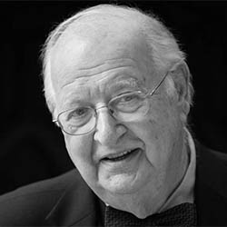
Can policy address these inequalities?
“In Britain at the beginning of the 19th century, inequality was vast compared with today. Wages were stagnant and would remain so for half a century. Profits were rising ...
Yet by century’s end reforms led to reduced fortunes of the aristocrats, extended political inclusion, wage began to rise and mortality started to fall
All of this happened without a collapse of the state, without a war, or a pandemic, through gradual change in institutions that slowly gave way to the demands of those who had been left behind.
Angus Deaton, Nobel Laureate in Economics
Notes:
Angus and the panel are optimistic about the ability of well designed policies to address these inequalities. Looking to the past Angus says we’ve been here before. At the turn of the last century the UK was a very unequal society. But some big ideas and big reforms led to considerable redistribution and improvements in the lives of the most vulnerable in society. So what are the policies needed to do that today?
-------
At the risk of grandiosity, I think that today’s inequalities are signs that democratic capitalism is under threat, not only in the US, where the storm clouds are darkest, but in much of the rich world, where one or more of politics, economics, and health are changing in worrisome ways. I do not believe that democratic capitalism is beyond repair nor that it should be replaced; I am a great believer in what capitalism has done, not only to the oft cited billions who have been pulled out of poverty in the last half century, but to all the rest of us who have also escaped poverty and deprivation over the last two and a half centuries. It also provides our jobs and the cornucopia of goods and services that we take for granted. And Milton Friedman, whose starry-eyed view of capitalism has much to answer for, was not entirely wrong when he extolled the freedom that free markets can bring. Though history has not been kind to his view that equality would be guaranteed by using markets to pursue freedom.

Slide 12
Focus in this talk is on jobs
While income is not the only inequality
  it is an important one
  and a good job might matter for more reasons than just the wage, a good job might also mean greater participation in society, the satisfaction of meaningful and gainful employment, affect child outcomes, etc.
We can tax top incomes and corporations to redistribute through the tax and benefit system
  but that is not enough
  what other policies do we need to address these inequalities?
Notes:
Having asked that very big question, I now want to focus on a very specific and much smaller aspect of inequalities.
I want to go back to income inequality and in particular ask what sorts of policies are needed to promote and encourage wage progression amongst low paid and low educated workers.
While income is not the only inequality it is an important one, and it is one that economic policy has a chance of addressing. And getting and keeping a good job matters for all sorts of reasons beyond the wage, as Trudeau emphasised in the quote at the start.
Inequality is a measure of dispersion and the gap between the low paid and the high paid. Much of policy discussion has focused on lower top incomes through taxes and regulations and redistributing through the tax and benefit system to the poor.
We definitely want to do that, and in the UK we do quite a bit of that. The story is different in the US. But that is not enough. We also want policies that address income inequality by raising the incomes of those at the bottom of the earnings distribution.

Slide 13
The challenge of growing income inequality
Strong earnings growth at the top, weak earnings growth at the bottom
Notes:
The challenge of growing income inequality is that we’ve seen strong earnings growth at the top
along with weak earnings growth at the bottom.
In fact wages have declined in real terms for low skilled in the US, while in the UK they have remained static.

Slide 14
Top 1% share of national income
USA
Canada
UK
Source: https://wid.world/data/
Notes:
This figure shows that over the past four decades in the US, UK and Canada we have seen the share of national income that is owned by the richest 1% has increased after a long period of decline, and are now back to levels seen a century ago.
Top incomes are high and rising, faster than incomes at the bottom
https://wid.world/data/

Slide 15
The challenge of growing income inequality
Strong earnings growth at the top
Little pay progression for the low educated
Notes:
Of more concern to me in this talk is the lack of pay progression for low educated workers

Slide 16
The less educated experience little wage growth over their career in the UK
Source: Costa Dias, Joyce and Parodi, IFS, 2018.
Notes:
These figures show wage progression over working life. On the horizontal axis we have age, and on the vertical axis we have mean hourly wage.
The left hand panel shows people with less than high school qualifications. The light green line is for women, the dark green for men. These lines are flat; low educated workers in the UK do not see wages increase over their working life.
This is in sharp contrast to the figure on the right for people with a university degree. Here we see that there is considerable pay progression; on average wages for men more than double over their working life.
---------
Notes: wages are shown in 2016 constant wage terms
Individuals in the bottom two and top one percentiles of the gender and year specific hourly wage distributions are excluded
Data from LFS 1993Q1-2017Q2.

Slide 17
Similar picture in the US
Source: Blundell, Joyce, Norris Keiller and Ziliak, IFS, 2018.
Notes:
the pictures is similar for the US, in the bottom right hand corner we see that workers with less than high school education experience little wage progression, while this with college or more see considerable wage progression.
---
Life-cycle growth in real median wages
Notes: CPS, Includes self employment income and self-employed households.
Data from CPS.

Slide 18
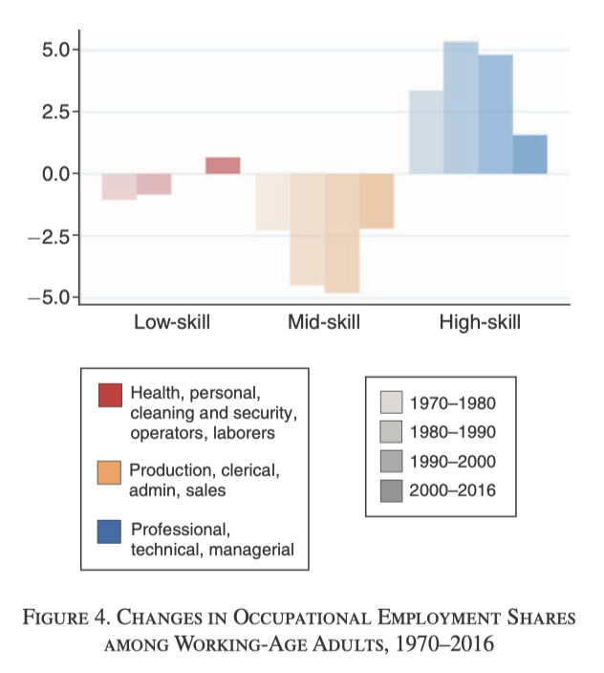
Automation is one likely cause
Change in employment shares of occupations in the US
Source: Autor, Ely lecture in AER P&P, 2019
Notes:
The reasons for these differing patterns are many, but one that has been emphasised in the economics literature is the “hollowing out” of the middle. New technologies, the automation of the workplace, and other forces such as trade, have led to a reduction in firms wanting to employ mid skilled workers. In particular, there has been a decline in demand for jobs that involve “routine tasks”, as these are the jobs that are most easily automated. Think of bank tellers and ATM machines.
This puts pressure on low wage jobs, as those workers previously employed in mid skill jobs are now competing for these low skilled jobs. The increase in firms wanting to hire high skilled workers, and the fact that mid skilled workers can not easily trade up to these jobs, increases wages in these jobs.
I want to return to this idea later in the talk, and particularly to consider whether there are some jobs for workers with low education but with some particular “human” on “non-routine” skills that complement these high skilled jobs. If there are then this might promise good jobs with wage progression for low educated workers.

Slide 19
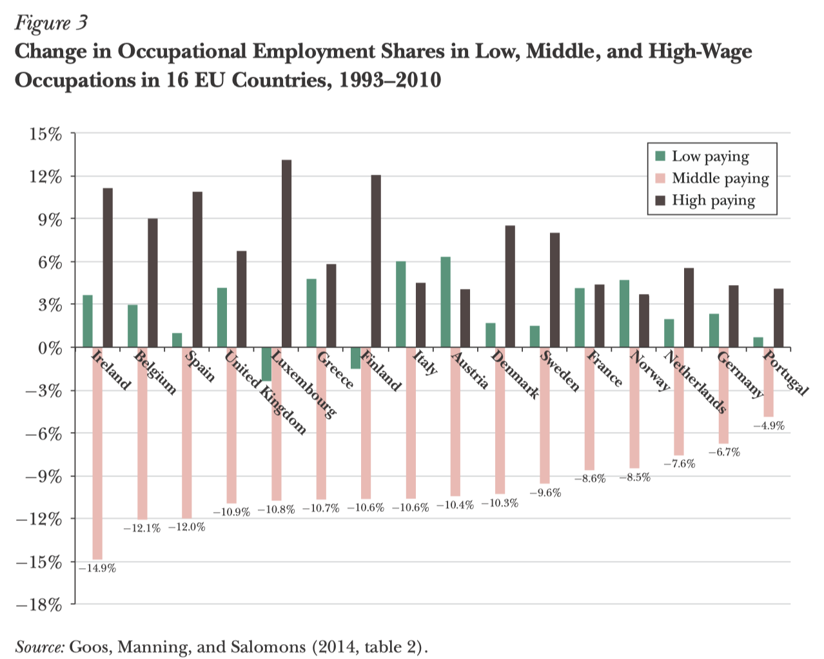
Source: Autor, JEP, 2015
Notes:
We see a similar pattern in European countries, with a decline in firms hiring workers in middle skilled and middle paying jobs.

Slide 20
The challenge of growing income inequality
Strong earnings growth at the top
Little pay progression for the low-skilled
  automation is one likely cause
  as well as the unequal impacts of increased globalisation, growing market power of superstar firms, etc.
Notes:
So automation is one likely reason for the lack of pay progression
but there are also many others, including the unequal affects of increasing globalisation, the growing market power of superstar firms as well as others

Slide 21
The challenge of growing income inequality
Strong earnings growth at the top
Little pay progression for the low-skilled
Increased female labour market participation
  but female employment growth has not reversed growth in household earnings inequality
Meaning that for poor households employment is increasingly not enough to move out of poverty or for longer run self-sufficiency
Notes:
The story is different for men and women. Female labour market participation, and so female earnings, have increased. However, this has not been enough to compensate for weak male earnings growth, and so household level earnings at the bottom have remained flat leading to growing inequality
All of this means that for poorer households it is no longer the case that getting a job is enough to move out of poverty for longer run self-sufficiency

Slide 22
The tax and benefit system
in the UK tax and benefit policy has mitigated the rise in inequality
Notes:
In the UK a progressive tax and benefit system has mitigated much of the low earnings growth at the bottom

Slide 23
The impact of the tax and benefit system
Working households’ pre-tax pay
Poorest
Richest
Source: Blundell, Joyce, Norris Keiller and Ziliak, IFS, 2018
Notes:
This figure shows the mean growth in earnings BEFORE taxes and benefits for working households in the UK between 1994 and 2015
Along the horizontal axis we have percentiles of household income; the poorest households are on the right and the richest on the left
Earnings growth is low at the bottom (except the very bottom) and rises for higher income households, showing what we saw in the previous figures
-----
Notes: Includes self employment income and self-employed households. Family Resources Survey. All income measures are equivalised.
Source: Blundell, Joyce, Norris Keiller and Ziliak (2018)

Slide 24
The impact of the tax and benefit system
Working households’ post-tax and benefits total income
Working households’ pre-tax pay
Poorest
Richest
Source: Blundell, Joyce, Norris Keiller and Ziliak, IFS, 2018
Notes:
The green line shows growth in earnings AFTER taxes and benefits.
We see for the richest households the green line lies below the red line, indicating that taxes and benefits reduced income growth between 1994-2015 over this period
For the poorest households the tax and benefit system does a lot, increasing growth in their post-tax earnings and more or less flattening the curve
-----
Family Earnings and Family Incomes:
Household income growth for working households in UK 1994/5 to 2015/6
Notes: Includes self employment income and self employed households. Family Resources Survey. All income measures are equivalised.
Source: Blundell, Joyce, Norris Keiller and Ziliak (2018)

Slide 25
The tax and benefit system
in the UK tax and benefit policy has mitigated the rise in inequality
but this is not sustainable
Notes:
So while the tax and benefit system has done a lot it is not sustainable, even before covid but certainly now

Slide 26
UK spending on working-age benefits
Almost doubled
Source: IFS calculations from DWP (UK) benefit expenditure tables.
Notes:
Spending on benefits has become a major part of the welfare state, almost doubling over the past two decades as a share of GDP
BUT this is not sustainable (note that the projected decline was pre-covid, this will have changed)
-------
Spending on working-age benefits
Sources: Benefit expenditure and caseload tables 2018, GDP at Market Prices and Money GDP (BKTL series), Budget 2001
Notes: 1948-1954 GDP based on calendar years. Includes cost of Children’s Tax Credit in 2001/02-2002/03, based on forecasts in Budget 2001

Slide 27
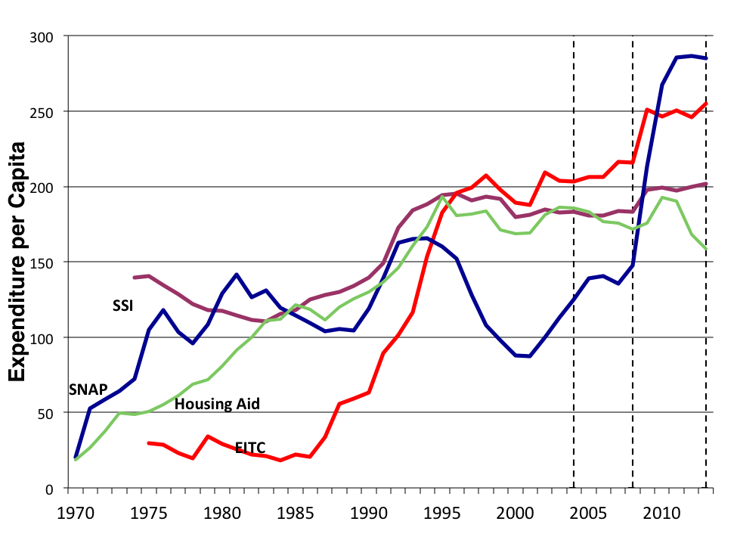
with the US experiencing similar growth
Source: Moffitt, 2018
Notes:
Growth in expenditure per capita on welfare transfers and EITC in the US has also grown considerably

Slide 28
Reforms in the UK since 2015 have reduced the generosity of benefits for the poorest
Fully implemented by April 2018
All
Planned or being rolled out
Source: IFS calculations using the IFS micro-simulation model run on the 2015‒16 FRS and 2014 LCFS.
Notes:
Reforms to the benefit system in the UK over the last few years are already reducing the degree of redistribution by reducing the generousity of benefits to the poorest.
-------
Note: Assumes full take-up of means-tested benefits and tax-credits. Policies partially rolled are Universal Credit, the 2-child limits, the replacement of DLA with PIP and the abolition of the WRAG premium in ESA.
Long run distributional impact of personal tax/benefit reforms in the UK since 2015 going forward…

Slide 29
A depressing finding
Little pay progression for low skilled workers
Employment is increasingly not enough to move out of poverty or for longer run self sufficiency
Pay growth at the top is accelerating away, leading to increasing inequality
What policies might help promote pay growth at the bottom?
Notes:
So this is all very depressing
What can we do?
What policies might help promote pay growth at the bottom?

Slide 30
What policies can we use?
In work benefits
  encourage employment of low wage workers
  are well-targeted to low earning families
  but not sustainable
  and may preserve low wage progression

Slide 31
What policies can we use?
In work benefits
Minimum wages
  play an important role
  but are not so well-targeted

Slide 32
Which working households in the UK get the extra money from the recent increase in the minimum wage?
Source: Cribb, Joyce and Norris Keiller, IFS, 2017.
Notes:
This figure shows the mechanical increase in net income arising from the increase in the minimum wage in the UK between 2018 and 2020, allowing for interaction with tax payments and benefit entitlements. It does not account for any behavoural responses by firms or workers.
It describes which working households get the extra money. Along the horizontal axis we have households rank in the household income distribution – with the poorest to the left and the richest to the right.
The key takeaway from this figure is that minimum wages, at least in the UK context, are not well targeted at the poorest households. It does benefit the poorest, but also those higher up to the middle of the income distribution and above.
--------
Source: Calculations using data underlying Figure 9 of Cribb, Joyce and Norris Keiller (2017): www.ifs.org.uk/publications/9205

Slide 33
What policies can we use?
In work benefits
Minimum wages
Human capital, training and promoting good jobs
  evidence suggests strong complementarity in returns to work experience with education
    more educated get paid more the more experience they get
  are there skills that are complementary with experience for low educated workers?
    some evidence suggests that firm based qualification training yields returns for low educated workers
    what is the nature of these jobs and this training?
    and what can policy do to encourage more of it?
Notes:
A large literature shows that there are strong complementarities between returns to experience with education – we saw that in the wage profiles we looked at in the start
it is the educated workers who experience the strongest wage progression
are there skills that are complementary with experience for low educated workers? Can we train or promote the acquisition of these skills?
Growing evidence that firm based qualification training leads to steeper wage profiles in low educated workers. What is the nature of these jobs and this training?

Slide 34
What types of low skilled jobs see wage progression?
Workers in some low-skilled occupations do experience wage progression and returns to experience
  they are similar on most observable characteristics to workers who don’t experience wage progression
  this is in line with a burgeoning literature that shows that similar workers get very different wages depending on the firm they match to
we emphasise that the workers who get goods wages are more likely to be in certain types of jobs
  those were certain types of soft skills are important
Notes:
Going back to the ideas in Autor’s work that the task content of jobs is important, we use the O*NET data to look at those low-wage, low-education jobs where “human skills”, i.e. those that are not easy to automate, are important

Slide 35
Examples of these soft skills and abilities
How important is coordination to the performance of your current job?
  Coordination: Adjusting actions in relation to others’ actions.
How important is active listening to the performance of your current job?
  Active Listening: Giving full attention to what other people are saying, taking time to understand the points being made, asking questions as appropriate, and not interrupting at inappropriate times
How important is it to work with others in a group or team in this job?

Slide 36
Examples of these soft skills and abilities
How important is social perceptiveness to the performance of your current job?
  Social Perceptiveness: Being aware of others’ reactions and understanding why they react as they do.
How important is problem sensitivity to the performance of your current job?
  Problem Sensitivity: The ability to tell when something is wrong or is likely to go wrong. It does not involve solving the problem, only recognizing that there is a problem.

Slide 37
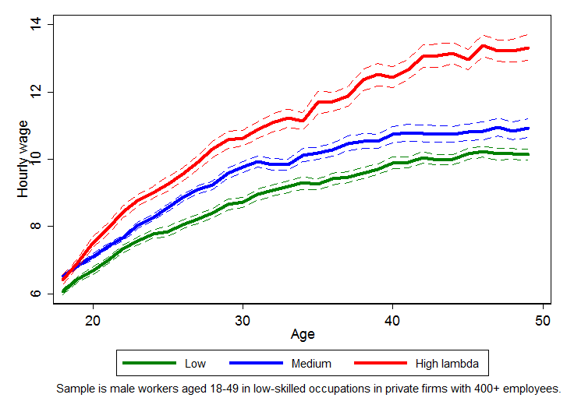
Workers in jobs where these soft skills are more important experience more wage progression
soft skills most important
soft skills least important
Source: Aghion, Bergeaud, Blundell and Griffith, IFS, 2020
Notes:
We construct a single index to measure the importance of these and other “human skills” and show that jobs where these the most important are those where workers experience the highest wage progression.
This opens up the possibility that policies that promoted these skills and abilities, perhaps early in life, might be effective – in combination with minimum wages and benefits.
In ongoing work, which I’ll talk about tomorrow, we dig into this idea to learn more about these workers and firms

Slide 38
Summary
Little wage progression for low educated workers
  meaning that employment is increasingly not enough to move out of poverty
Increased female earnings has not been sufficient to overcome family earnings inequality
The benefit system is well targeted at low earning families, but is unsustainable as the only policy tool
Minimum wages lift hourly wages, but are not well targeted at low earning families
Notes:
Little wage progression for low educated
employment is not enough to escape poverty or for self-sufficiency
Increased female labour supply
not overcome family earnings inequality;
assortativeness and low earnings share
Tax credits well targeted to low earning families
but no sustainable, and doesn’t necessarily promote wage progression
Minimum wage has lifted hourly wages at the bottom
but not well-targeted to low earning families, though is likely to be an important part of the policy mix

Slide 39
Designing the best policy mix
What limits wage progression at the bottom?
  lack of skills and training?
What skills leads to good jobs for low educated workers?
  should we focus on soft skills and early years investments?
[What policies can increase earnings of low wage females?]
[Do we need stronger competition policy and contract regulation alongside redistributive tax and benefit system and minimum wage polices?]
Notes:
What limits wage progression at the bottom?
a lack of skills and training? or other factors?
What skills among those with lower education are valued by ‘good /growing’ firms?
skills that complement innovation are less likely to be out-sourced,
‘soft skills’ seem key => re-think qualification firm-based training and the role of technology.
Many things I did not talk about
What policies can increase the wages of females so that they can play a bigger role in reducing household earnings inequality?
Do we need stronger competition policy and contract regulation alongside redistributive tax credit and min wage policies?
increasing mark power, and growth of the gig economy may signal declining bargaining power of lower educated workers... what policies would be beneficial here?

